Slide 1

S D SUPRAJA
Final Project
22/6/2024 Annual review
1

Slide 2

KEYLOGGER AND SECURITY
A keylogger or keystroke logger/keyboard capturing is a form of malware or hardware that keeps track of and records your keystrokes as you type. It takes the information and sends it to a hacker using a command-and-control (C&C) server. The hacker then analyzes the keystrokes to locate usernames and passwords and uses them to hack into otherwise secure systems.
22/6/2024 Annual Review
2

Slide 3



AGENDA
Introduction to the project
Problem statement
Project overview
Who are the end users
Solution and its value proposition
The ‘wow’ factor in the solution
Modelling
Results and conclusion
22/6/2024 Annual Review
3

Slide 4
PROBLEM STATEMENT
Keyloggers are software programs designed to capture and record keystrokes made by a user on a computer. While keyloggers can serve legitimate purposes such as monitoring employee activities or detecting unauthorized access attempt.
Data Encryption: Encrypt captured keystrokes to ensure confidentiality
Access Control: Implement strict installation or use of the keylogger.
Anomaly Detection: Employ algorithms to detect suspicious behavior patterns.
Notification System: Alert administrators or users of suspicious activities
22/6/2024 Annual Review
4

Slide 5
PROJECT OVERVIEW
The purpose of this project is to design and develop a keylogger software application. Capture and record keystrokes made by users on a designated computer system, ensuring security and ethical use.Develop the keylogger to operate on Windows, macOS, and Linux platforms.Use languages like Python, C++, or Java depending on platform compatibility and performance requirements.
This overview provides a structured approach to developing a keylogger software application, outlining its purpose, scope, technical specifications, development stages, challenges, and expected deliverables. It emphasizes the importance of security, compliance, and ethical considerations throughout the project lifecycle
22/6/2024 Annual Review
5

Slide 6
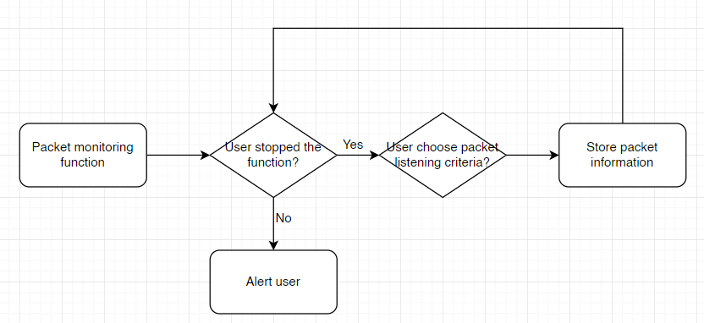

WHO ARE THE END USERS?
Security Monitoring: Companies may use keyloggers to monitor employee activities on company-owned devices to prevent insider threats.
Productivity Monitoring: Some organizations use keyloggers to analyze employee productivity by tracking keystrokes and time spent on various applications or tasks.
Child Safety: Parents may install keyloggers on family computers to monitor their children's online activities.
Behavior Monitoring: Keyloggers can help parents understand their child's behavior online.
22/6/2024 Annual Review
6

Slide 7
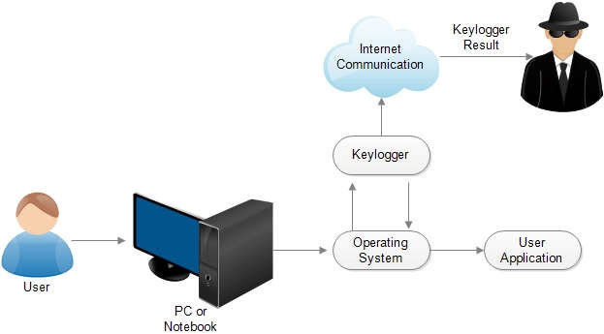
YOUR SOLUTION AND ITS VALUE PROPOSITION
Advanced Encryption: Implement robust encryption algorithms (e.g., AES-256) to secure captured keystrokes during transmission and storage.
Access Control: Utilize strong access control mechanisms to prevent unauthorized access to logged data, maintaining the integrity of captured information.
Real-time Alerts: Incorporate a notification system to alert administrators or users of suspicious activities or attempts to tamper with the keylogger.
Activity Reports: Generate comprehensive reports on logged activities, aiding in behavioral analysis and compliance auditing purposes.
22/6/2024 Annual Review
7

Slide 8
THE ‘’WOW ‘’ FACTOR IN THE SOLUTION
Wow Factor: Redefining Monitoring with Advanced Security and Insight..
Military-Grade Encryption: Employ AES-256 encryption to safeguard captured keystrokes, ensuring unparalleled data security against unauthorized access.
Tamper-Proof Design: Implement robust access controls and real-time alerts to thwart tampering attempts, securing sensitive information from any malicious interference.
Cross-Platform Compatibility: Support Windows, macOS, and Linux environments seamlessly, empowering organizations with flexible deployment options across diverse IT infrastructures.
Transparency and Consent: Prioritize user awareness and consent through transparent communication about monitoring practices..
22/6/2024 Annual Review
8

Slide 9
MODELLING
Modelling in the context of a keylogger typically involves designing the software architecture and behavior to ensure it meets functional requirements while adhering to security and ethical standards.
Resource Utilization: Determines how efficiently the keylogger operates without impacting system performance.
Optimization Techniques: Improves logging efficiency through batch processing or data compression.
Interface Mockups: Designs user-friendly interfaces for configuring settings and viewing logs.
Accessibility: Ensures ease of use and clarity in displaying monitoring data,alerts.
22/6/2024 Annual Review
9

Slide 10
RESULTS AND CONCLUSION
In conclusion, developing a keylogger involves not only technical expertise but also a commitment to ethical principles, user trust, and regulatory compliance. By prioritizing security, transparency, and user-centric design, developers can create a keylogger solution that effectively meets monitoring needs while safeguarding privacy and promoting responsible usage in organizational and personal contexts.
By emphasizing security, transparency, and compliance, it seeks to enhance digital security measures while safeguarding user privacy and upholding ethical standards.
22/6/2024 Annual Review
10

Slide 11
PROJECT LINK
https://github.com/suprajasd29/keylogger

